Slide 1
Agenda
Time | Session | Details
08:30 - 09:00 | Settle in
09:00 - 09:30 | Introduction – Insight into Ameriprise goals for modernization | Understanding Ameriprise’s pain points and modernization goals. Ameriprise team to present.
09:30 - 10:15 | Executive perspective – Role of IBM Z in Hybrid cloud. | Covers approach to enterprise modernization and enabling mainframe in a hybrid cloud environment.
10:15 – 11:00 | Mainframe Update | Session Latest happenings on IBM Z (mainframe)
11:00 – 11:15 | Break
11:15 – 12:30 | End to end DevOps Journey for mainframe | Discuss details on approach to end to end Devops, current state, proposed architecture and next steps. This will also cover a deep dive on GIT Migration from legacy SCMs.
12:30 – 1:00 | Lunch
1:00 – 1:45 | Data Modernization with Analytics on Z | Introduction to IBM z Open Data Analytics, use cases for Analytics on the mainframe and benefits of doing this.
1:45 – 2:30 | Service Discovery & API Enablement | Infosys approach to identifying services from existing applications, API enable them and relating that to stands in do gap analysis.
2:30 – 3:00 | Wrap up & Next Steps

Slide 2
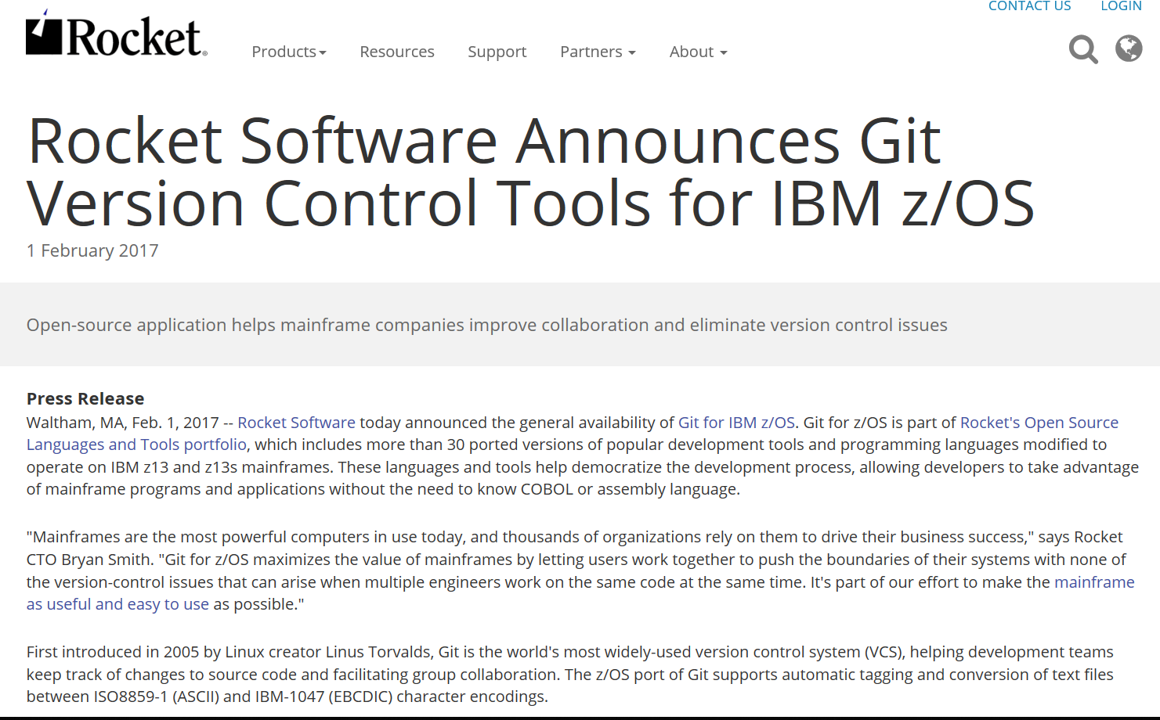
Rocket Software’s Port of Git to z/OS

Slide 3
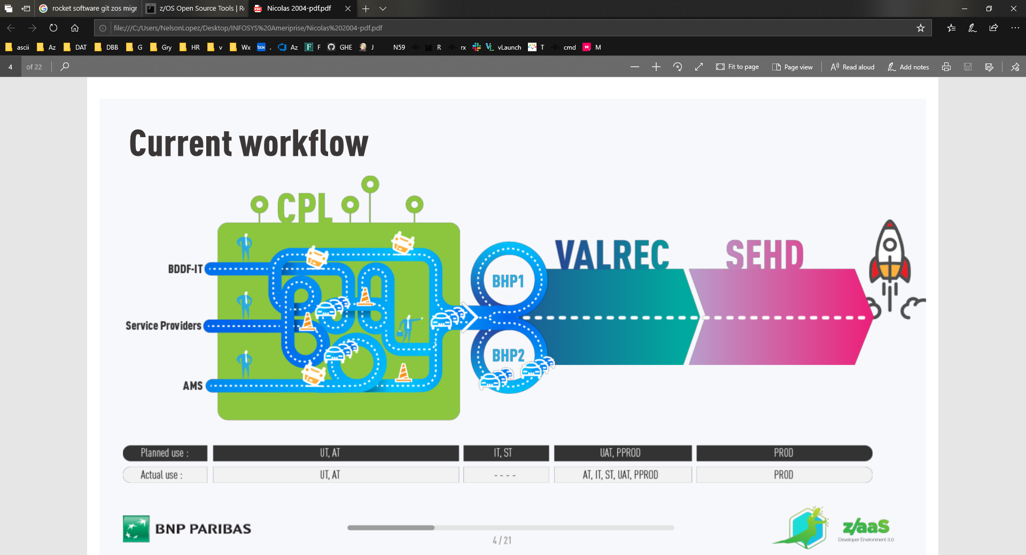
Case Study- BNP Paribas

Slide 4
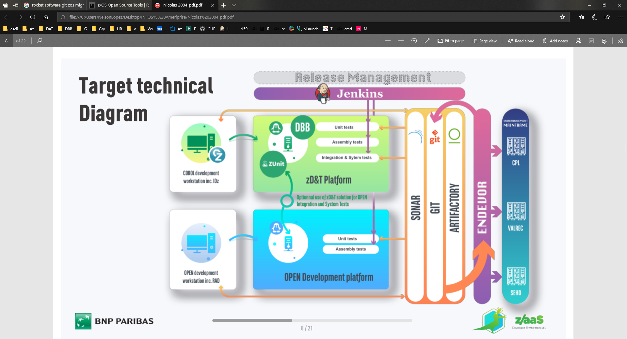

Slide 5
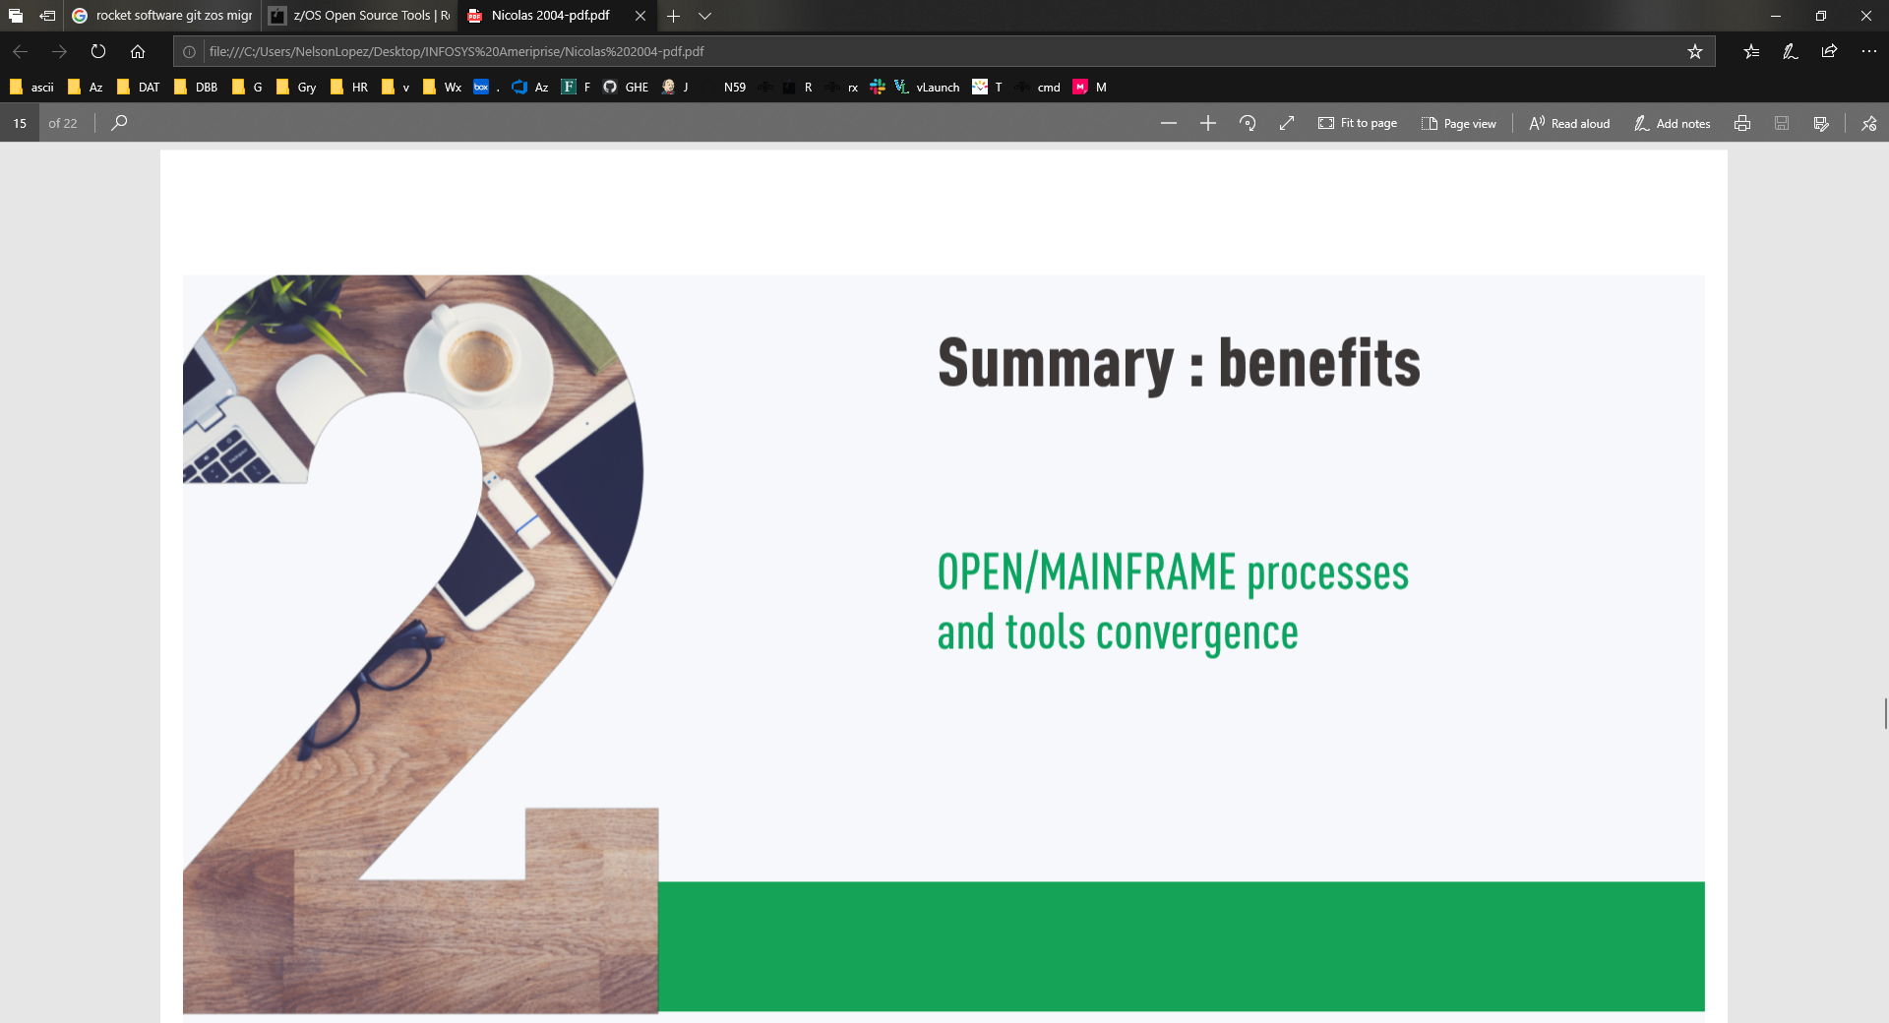

Slide 6
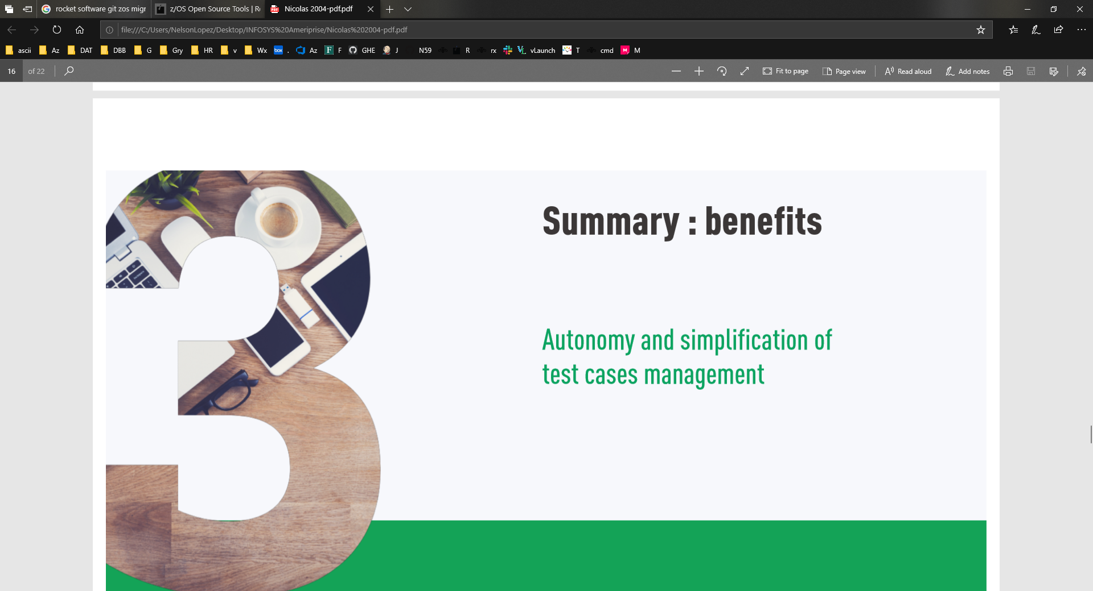

Slide 7
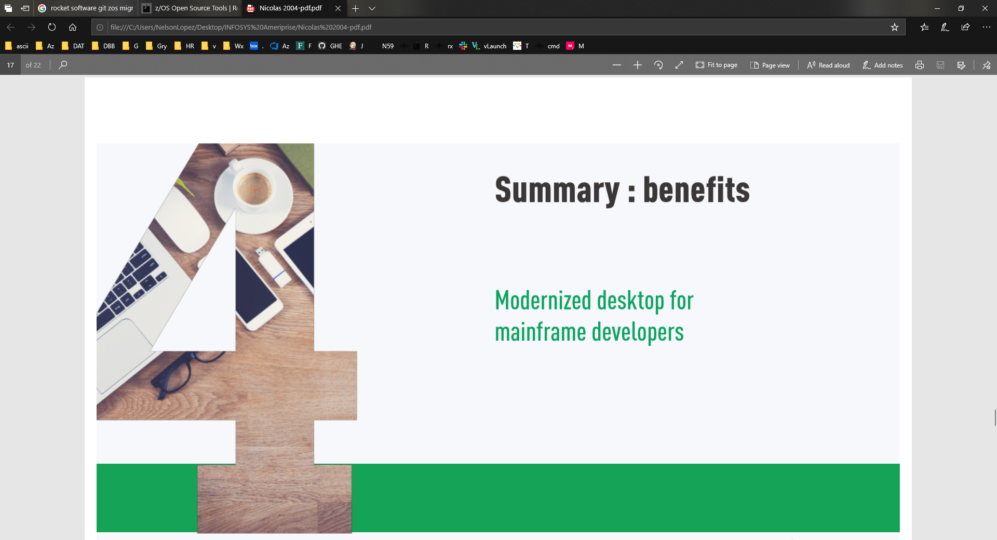

Slide 8
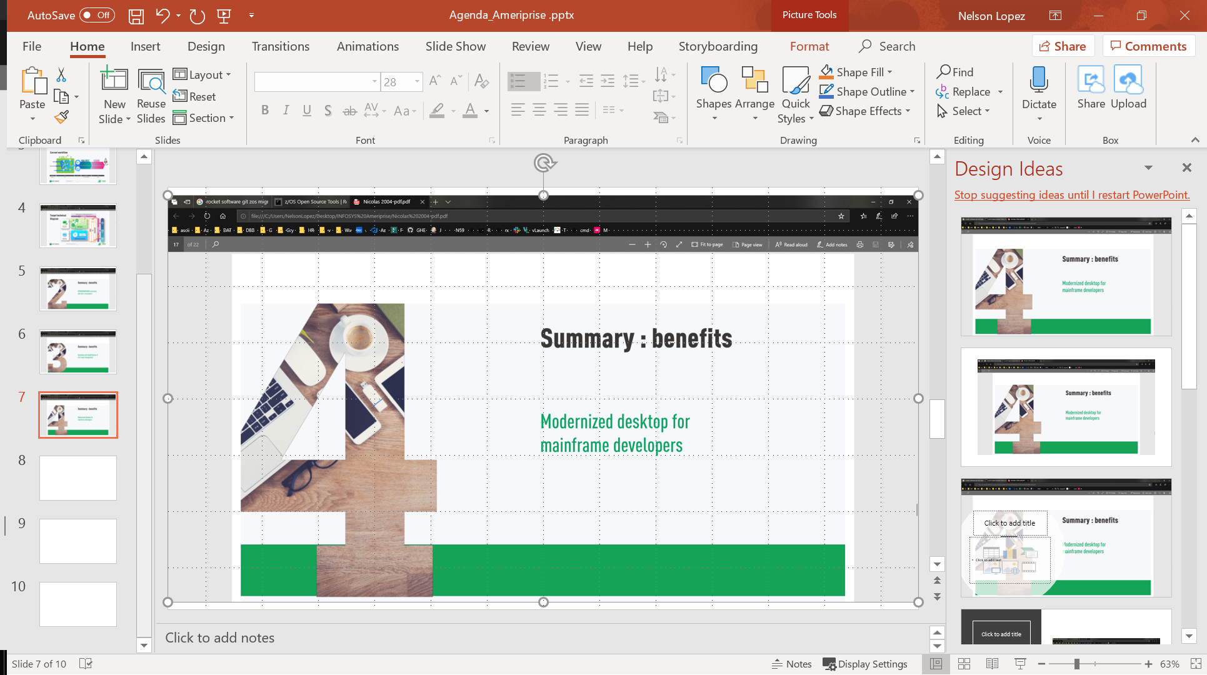

Slide 9
